Slide 1
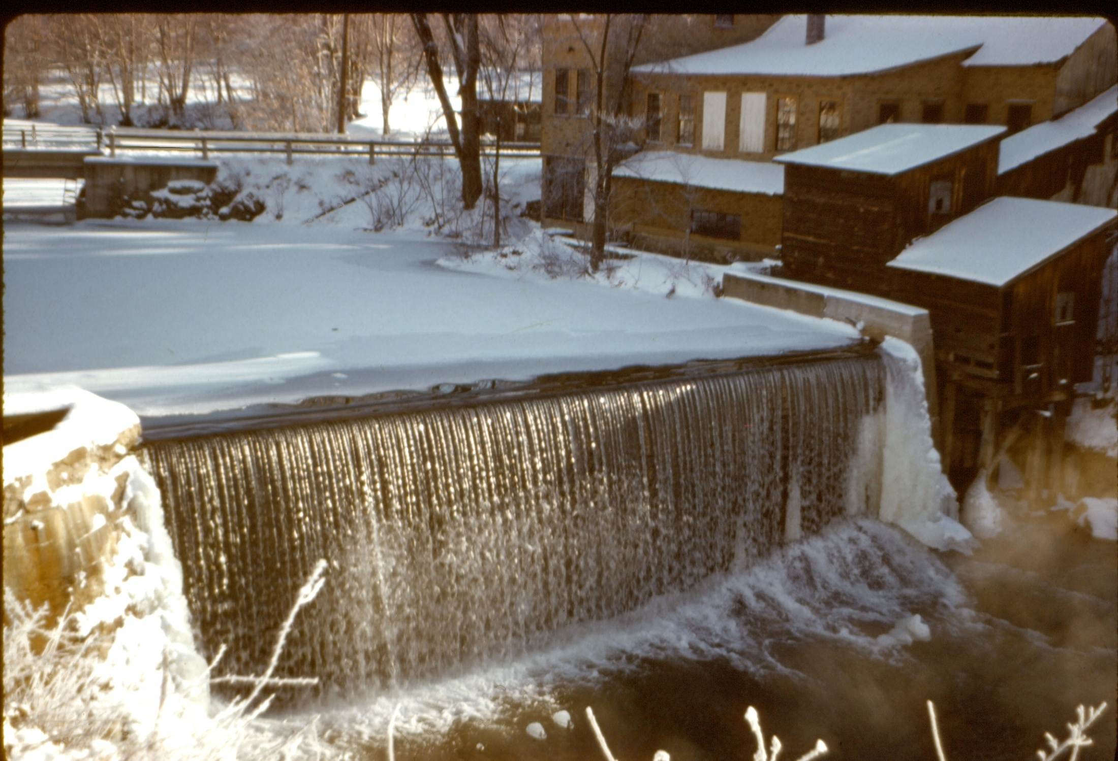
North Hadley Dam

Slide 2
Background of 1965-1966 dam repair
As the owner of a general store next to the dam, Earl Hahn also owned the water rights of Lake Warner. Following a dam inspection by State authorities in the early 1960’s, he was advised that as water rights owner, he was liable for damages should the dam fail. Earl Hahn offered to transfer the water rights to either the town of Hadley or the state of Massachusetts, as the lake was used as a source of water for town fire protection (There were no fire hydrants in North Hadley at this time).
Both the town of Hadley and the State of Massachusetts refused to accept the Lake Warner water rights. In addition they refused to contribute to the cost of the dam repairs.
The need for dam repairs was publicized in the Daily Hampshire Gazette. Donations were received from approximately ten North Hadley and Amherst citizens who had used Lake Warner for recreational purposes. The majority of the expense for the dam repair was shared equally by Earl Hahn, water rights owner; Joseph Klimoski, owner of the former C. D. Dickenson knife works adjacent to the dam, and Robert Hahn, lake abutter.

Slide 3
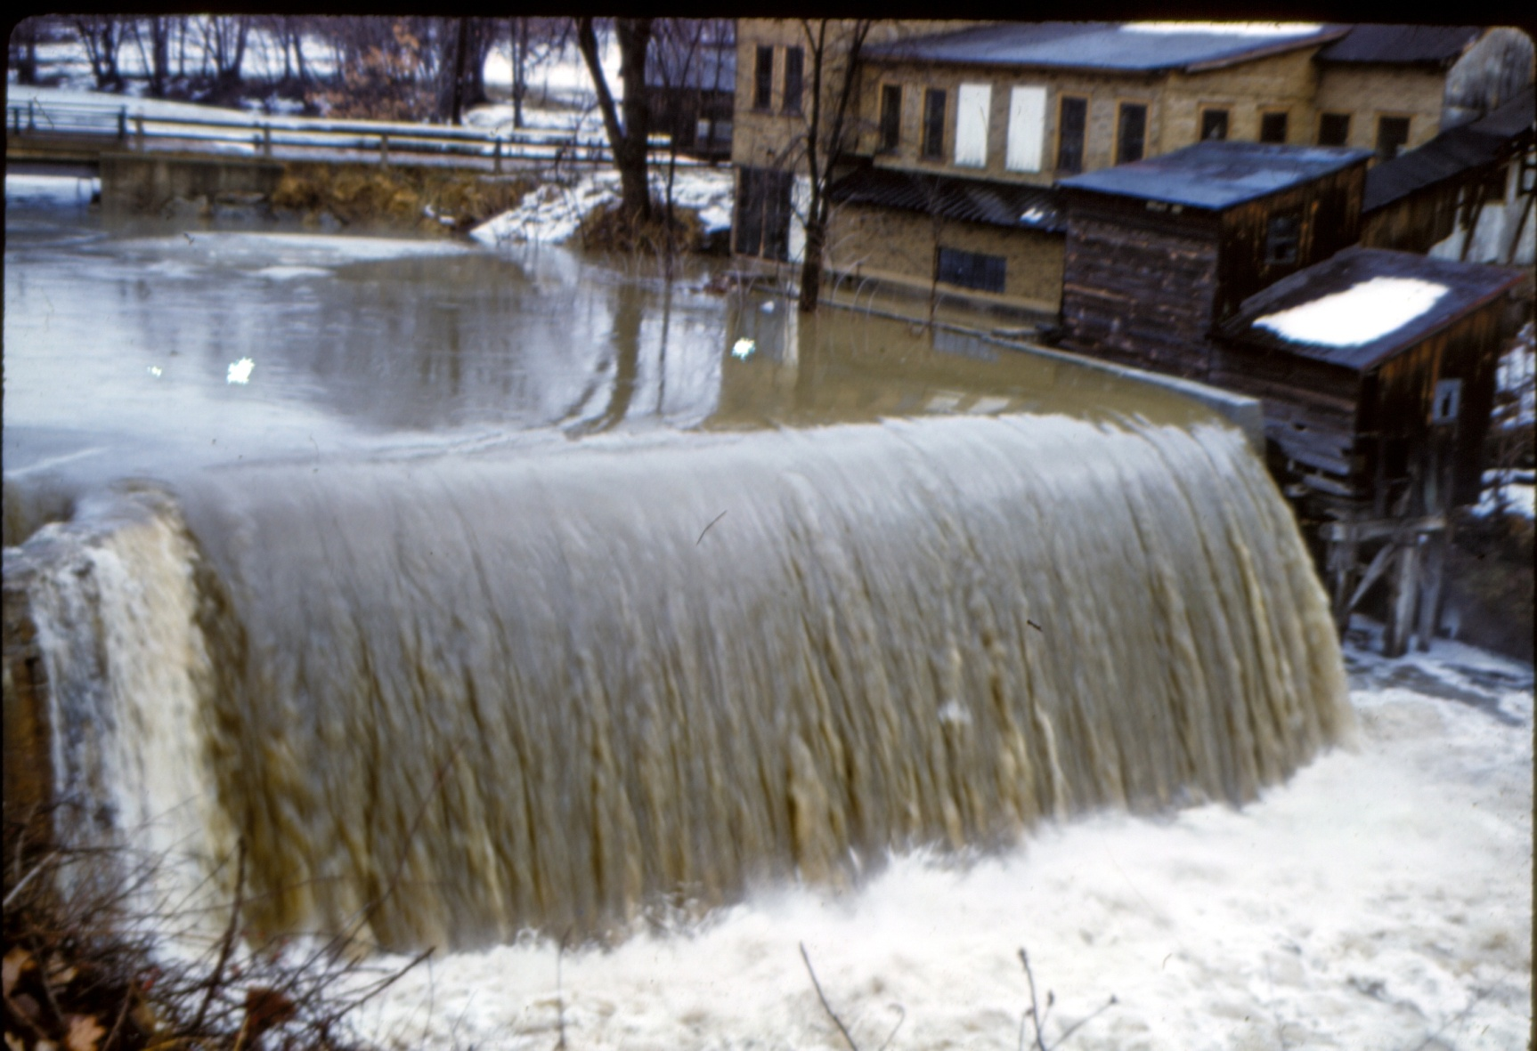
Spring Flood

Slide 4
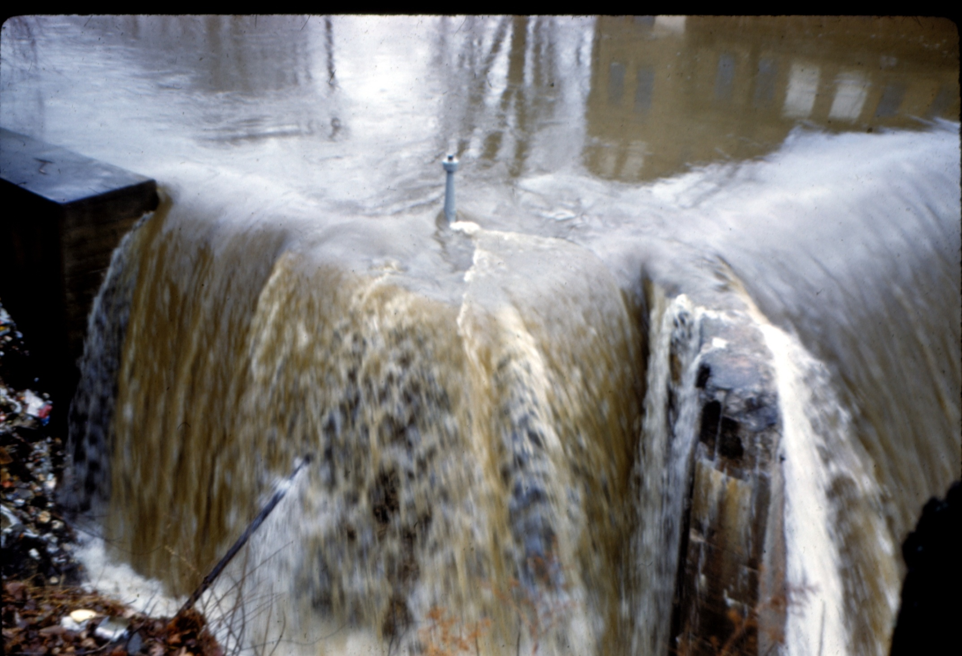
Spring Flood overflowing side gate control

Slide 5
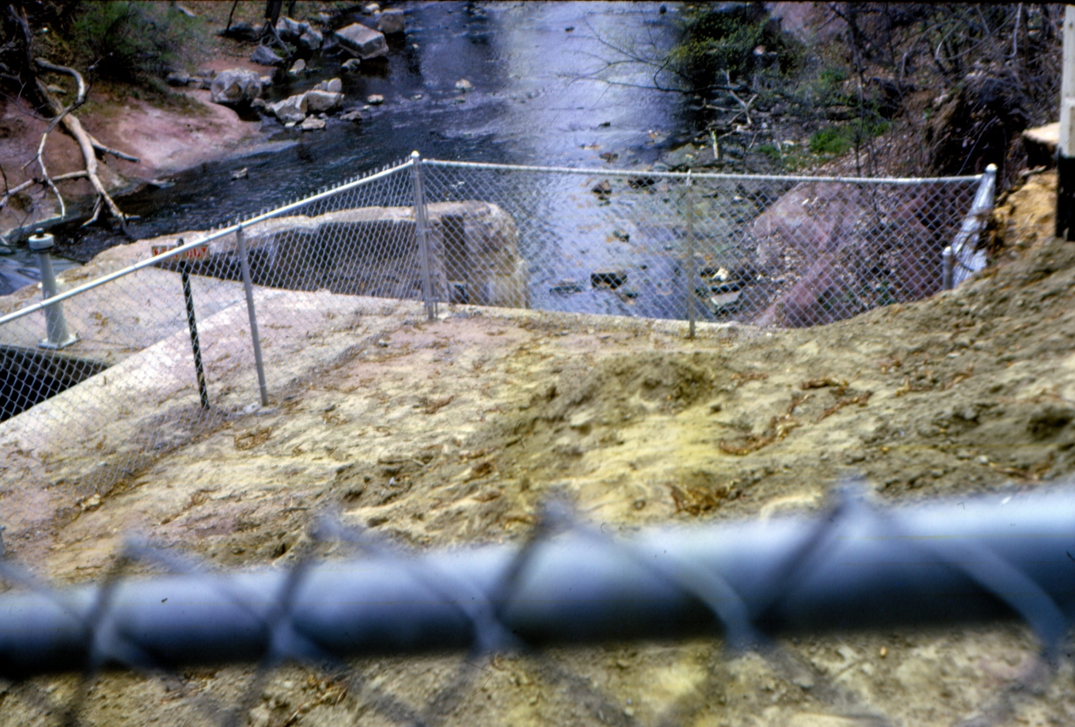
Downstream of dam
New Wall
Gate control
Old side wall
following reinforcement

Slide 6
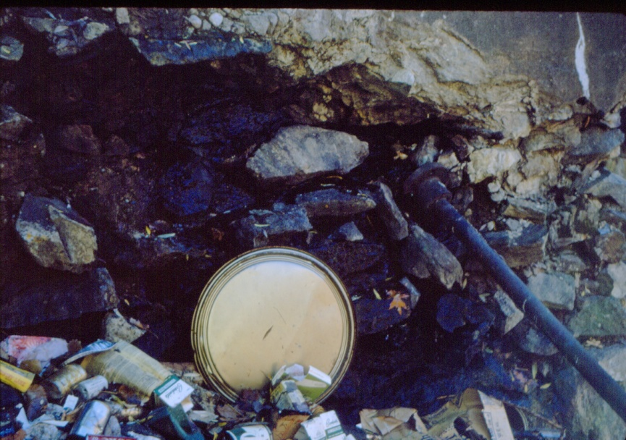
Old side wall before reinforcement

Slide 7
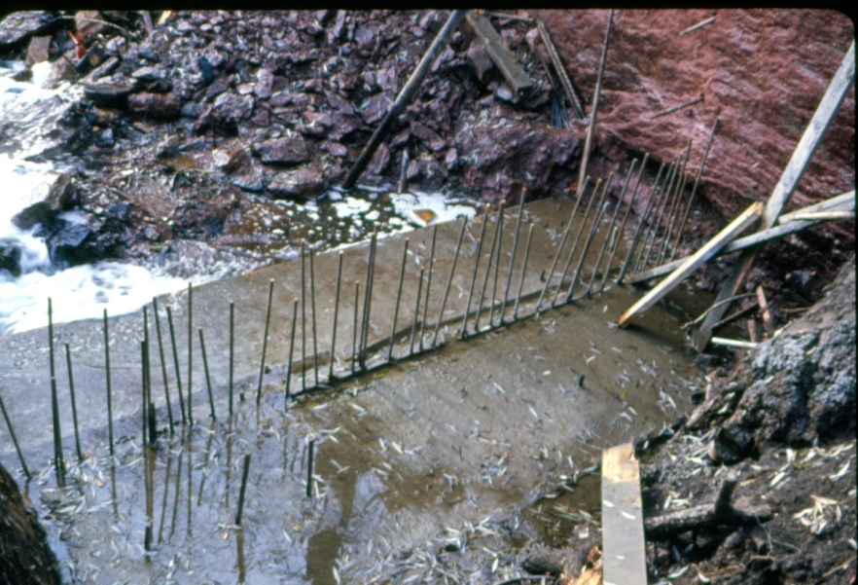
Foundation of New Wall

Slide 8
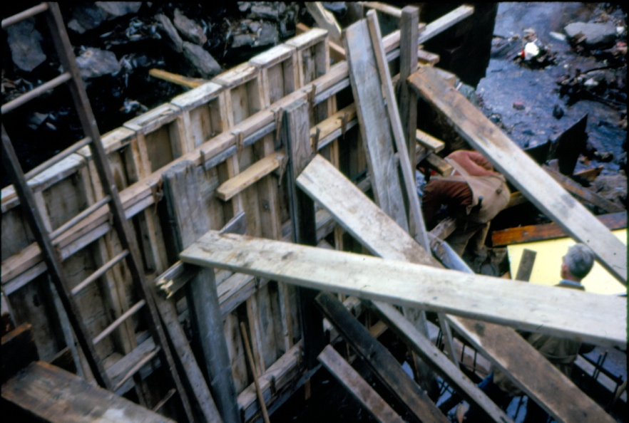
Reconstruction of old side wall

Slide 9
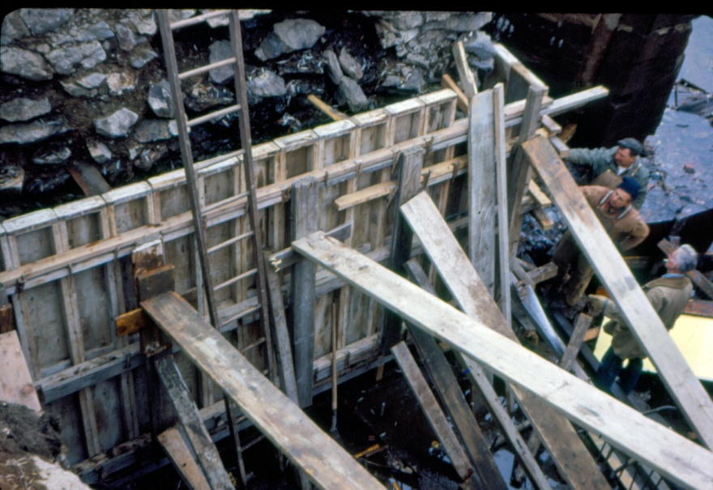
Reconstruction of old side wall

Slide 10
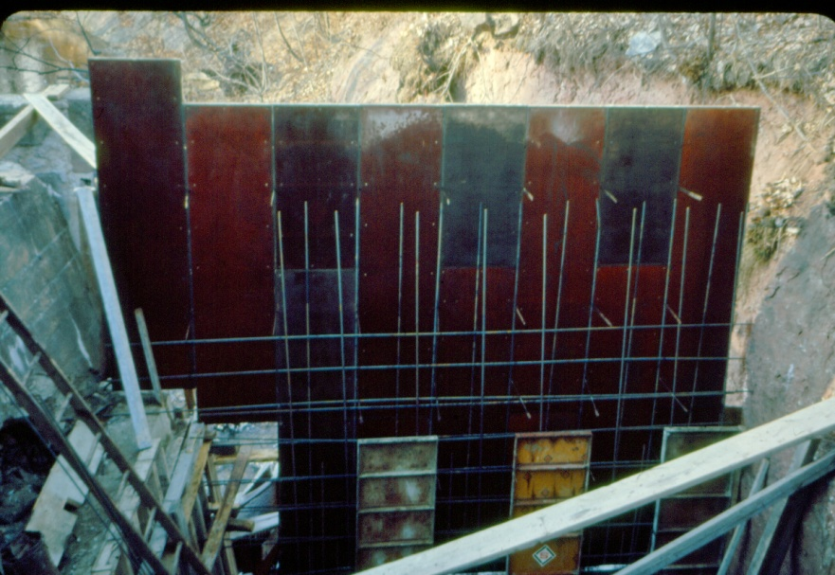
New Wall
Reconstructed side wall

Slide 11
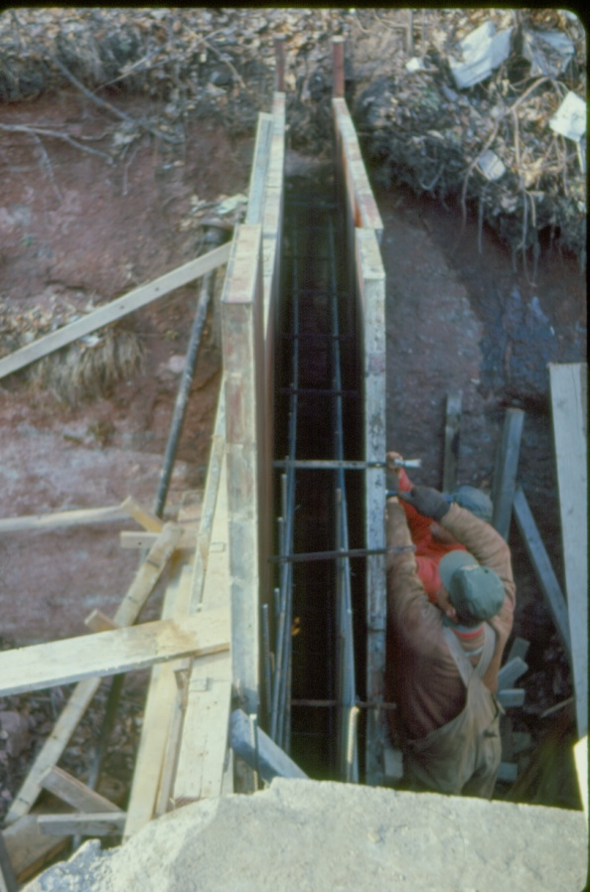
New Wall

Slide 12
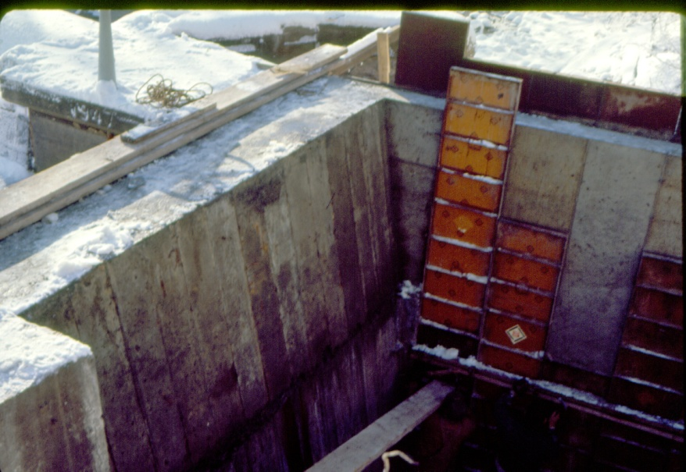
Gate control
New Wall
Reconstructed side wall

Slide 13
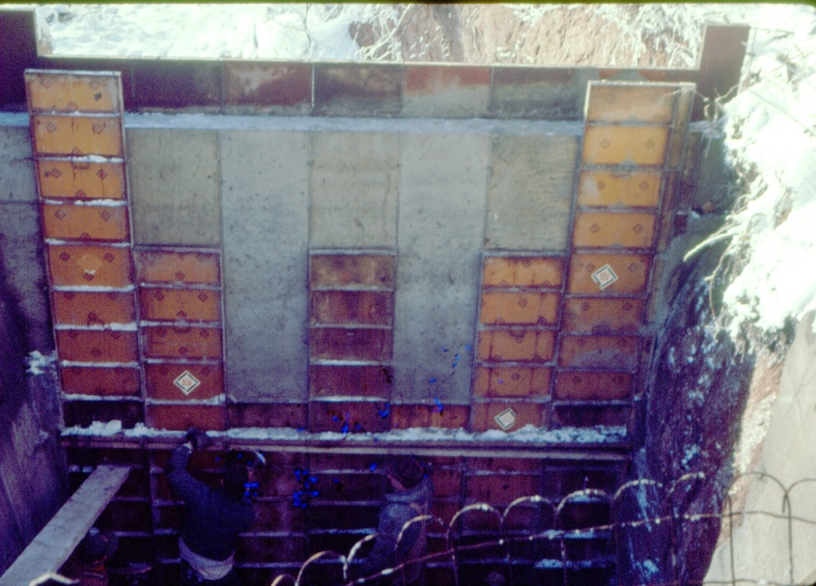
New Wall

Slide 14
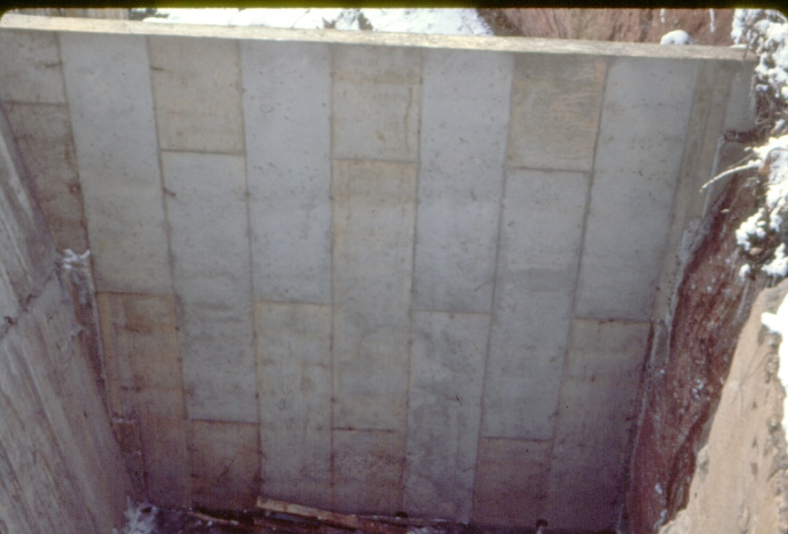
New Wall

Slide 15
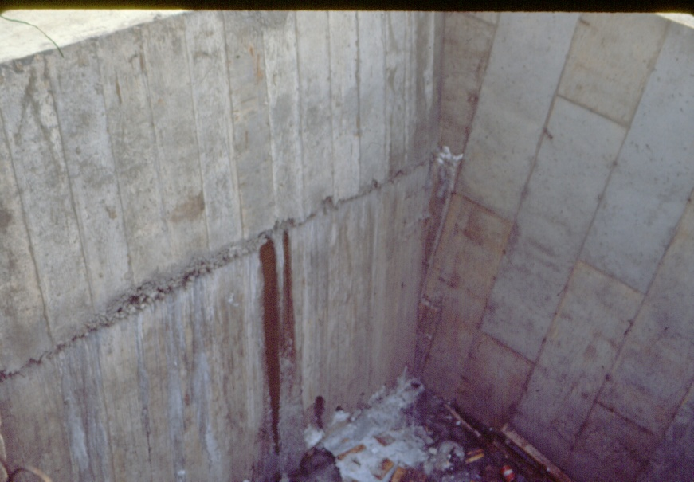
Reconstructed side wall
New Wall

Slide 16
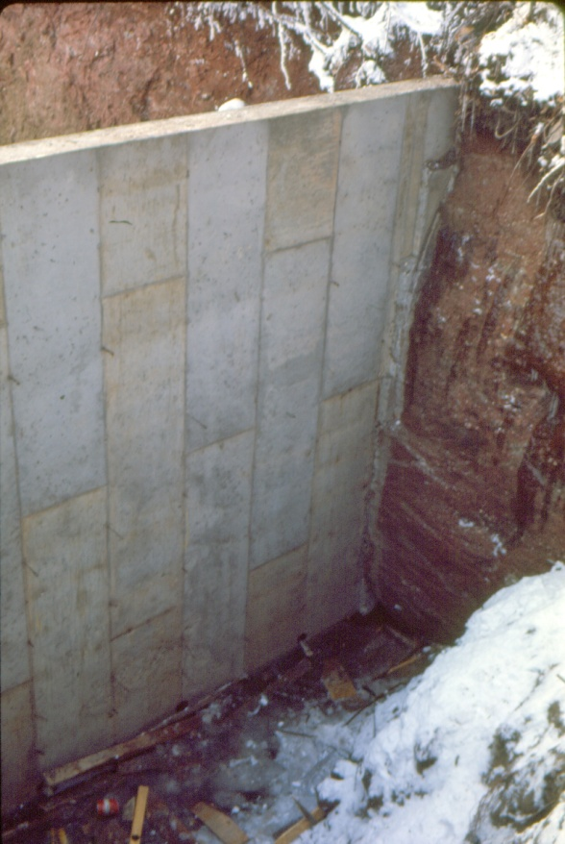
New Wall

Slide 17
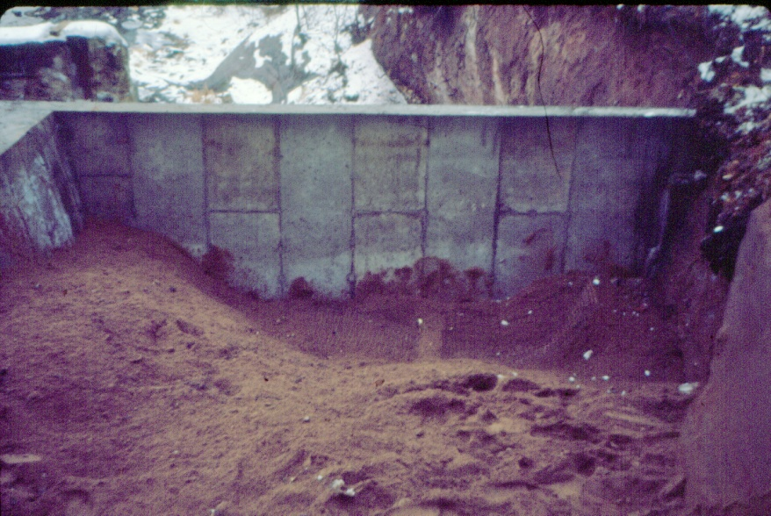
New Wall backfilled with sand

Slide 18
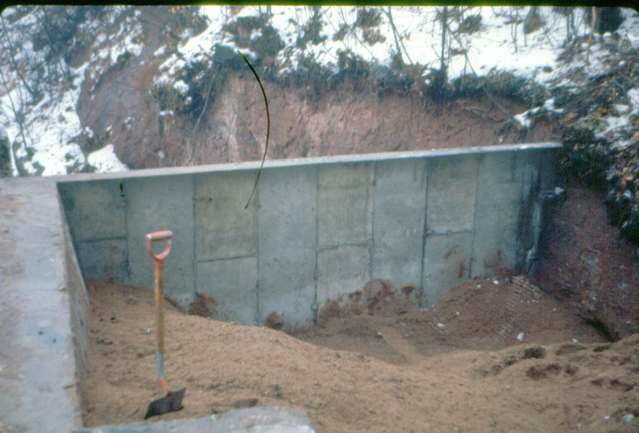
New Wall backfilled with sand

Slide 19
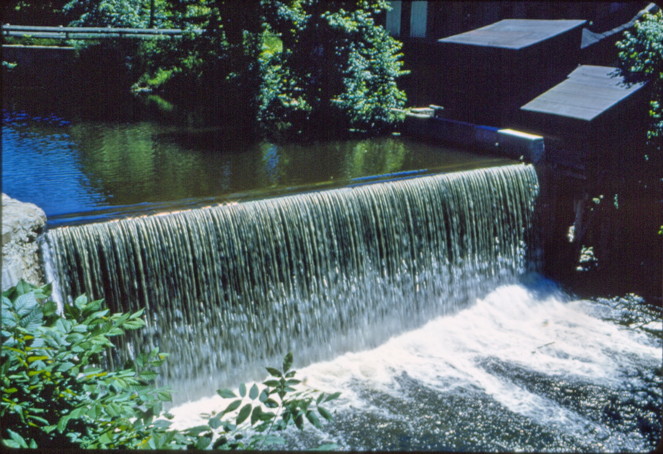
The End

